Slide 1
Quiz on Lecture 10
Please receive the quiz handout from Cyrille, Oliver, Vincent, Jan
Complete the quiz in silence
Hand the quiz back

Slide 2
Quiz on Lecture 10
What is the primary function of the MLflow Tracking component?
  To serve as a central, versioned repository for models ready for deployment
  To deploy the model to a production environment for real-time inference
  To log parameters, code versions, metrics, and artifacts from machine learning code runs
  To provide a standard format for packaging machine learning models that can be easily deployed
Why might you avoid using mlflow.autolog() in production code?
  It requires a paid subscription to use in a production environment.
  It only works for the Scikit-learn library
  It significantly slows down the model training process compared to manual logging
  It logs everything by default, which can be noisy, and the hidden process makes debugging harder
Which MLflow CLI command is used to deploy a registered model as a local REST API endpoint for real-time predictions?
  mlflow models predict
  mlflow models deploy
  mlflow ui
  mlflow models serve
A data scientist tries to re-run its training notebook with the same code, but gets different results. What is a primary cause for this Lack of Reproducibility in traditional ML workflows?
  The model's performance in production was drifting over time
  The colleague's computer has a different processor
  The exact library versions and data preprocessing steps were not saved and versioned with the experiment
  The colleague used a different algorithm to train the model
What is the primary benefit of using MLflow in conjunction with an orchestrator like Dagster?
  To automate & log the end-to-end ML workflow, from experimentation to deployment
  To be able to monitor concept & data drift more reliably
  To manage and version the source code in a Git repository
  To provide a standard format for packaging machine learning models.

Slide 3
Quiz on Lecture 10 (Answers)
What is the primary function of the MLflow Tracking component?
  To serve as a central, versioned repository for models ready for deployment
  To deploy the model to a production environment for real-time inference
  To log parameters, code versions, metrics, and artifacts from machine learning code runs
  To provide a standard format for packaging machine learning models that can be easily deployed
Why might you avoid using mlflow.autolog() in production code?
  It requires a paid subscription to use in a production environment.
  It only works for the Scikit-learn library
  It significantly slows down the model training process compared to manual logging
  It logs everything by default, which can be noisy, and the hidden process makes debugging harder
Which MLflow CLI command is used to deploy a registered model as a local REST API endpoint for real-time predictions?
  mlflow models predict
  mlflow models deploy
  mlflow ui
  mlflow models serve
A data scientist tries to re-run its training notebook with the same code, but gets different results. What is a primary cause for this Lack of Reproducibility in traditional ML workflows?
  The model's performance in production was drifting over time
  The colleague's computer has a different processor
  The exact library versions and data preprocessing steps were not saved and versioned with the experiment
  The colleague used a different algorithm to train the model
What is the primary benefit of using MLflow in conjunction with an orchestrator like Dagster?
  To automate & log the end-to-end ML workflow, from experimentation to deployment
  To be able to monitor concept & data drift more reliably
  To manage and version the source code in a Git repository
  To provide a standard format for packaging machine learning models.

Slide 4
Designing and Deploying
end-to-end
Production Grade ML Applications
Lecture 11: Distributed vs Single-thread Compute
October 2025
Oliver Angélil

Slide 5
Contents of this lecture
What is Spark and how does it work?
Why was Spark was created?
When and when not to use Spark
Scanning table sizes on Databricks workspaces at company X -> Problem
Potential solutions & Performance comparison with the best alternative
Conclusions
Benchmarking Pandas (single thread) & Polars (multi thread) — classroom exercise

Slide 6
1. What is Spark and how does it work?
End-user perspective: pandas but for big data (terabytes & beyond)
Technological perspective: Spark is a distributed (i.e. multi-node) cluster computing framework for processing large amounts of data in parallel
Your laptop has 1 node
A Spark cluster has multiple nodes
One Node
Worker Node
CPU
memory
core
core
storage
Worker Node
Driver Node
Worker Node
core
core
Cores determine the number of parallel tasks that can run concurrently. e.g. with 4 cores ("quad core"), 4 tasks can run in parallel, or more if there are multiple threads per core
Memory determines how much data can be loaded & actively worked on at once
This Spark cluster has 4 ("worker") nodes, but it can be scaled up to have many more 🚀
Each node is a standalone "computer" (VM) that is spun up in real-time on the cloud
Worker Node

Slide 7
1. What is Spark and how does it work?
Performing a left join in a non-distributed fashion
Time complexity:
8x8 = 64 comparisons
Table A
Table B
Employee ID | Car ID
BC123 | 111
BC123 | 888
BC234 | 222
BC345 | 777
BC456 | 333
BC456 | 666
BC567 | 444
BC678 | 555
Car ID | Car Name
111 | Porsche
222 | Lamborghini
333 | Alfa Romeo
444 | Ferrari
555 | McLaren
666 | Aston Martin
777 | Audi
888 | Mercedes
Employee ID | Car ID | Car Name
BC123 | 111 | Porsche
BC123 | 888 | Mercedes
BC234 | 222 | Lamborghini
BC345 | 777 | Audi
BC456 | 333 | Alfa Romeo
BC456 | 666 | Aston Martin
BC567 | 444 | Ferrari
BC678 | 555 | McLaren
➕
(join)
🟰
* time complexity: O(N²)

Slide 8
1. What is Spark and how does it work?
Performing a left join in a distributed fashion (i.e. with Spark)
Step 1: Load parquet files into memory
Whoops! Join keys are on different nodes 😟
Worker Node
Worker Node
parquet file A.1
parquet file B.1
parquet file A.3
parquet file B.3
Employee ID | Car ID
BC123 | 111
BC123 | 888
Car ID | Car Name
111 | Porsche
222 | Lamborghini
Employee ID | Car ID
BC456 | 333
BC456 | 666
Car ID | Car Name
555 | McLaren
666 | Aston Martin
Worker Node
Worker Node
parquet file A.2
parquet file B.2
parquet file A.4
parquet file B.4
Employee ID | Car ID
BC234 | 222
BC345 | 777
Car ID | Car Name
333 | Alfa Romeo
444 | Ferrari
Employee ID | Car ID
BC567 | 444
BC678 | 555
Car ID | Car Name
777 | Audi
888 | Mercedes

Slide 9
1. What is Spark and how does it work?
Time complexity:
2x2x4 = 16 comparisons
4x less than non-distributed! 😎
Performing a left join in a distributed fashion (i.e. with Spark)
Step 2: Shuffle rows across machines so join keys are together
Worker Node
Worker Node
parquet file A.1
parquet file B.1
parquet file A.3
parquet file B.3
Employee ID | Car ID
BC123 | 111
BC123 | 888
Car ID | Car Name
111 | Porsche
888 | Mercedes
Employee ID | Car ID
BC456 | 333
BC456 | 666
Car ID | Car Name
333 | Alfa Romeo
666 | Aston Martin
Worker Node
Worker Node
parquet file A.2
parquet file B.2
parquet file A.4
parquet file B.4
Employee ID | Car ID
BC234 | 333
BC345 | 777
Car ID | Car Name
333 | Alfa Romeo
777 | Audi
Employee ID | Car ID
BC567 | 444
BC678 | 555
Car ID | Car Name
444 | Ferrari
555 | McLaren
* hash of join key is taken, and records within some range are sent to same node

Slide 10
1. What is Spark and how does it work?
Spark was invented by a group of nerds that founded Databricks
Clever way to process large tables! 😻
Performing a left join in a distributed fashion (i.e. with Spark)
Step 3: Perform join in parallel
Worker Node
Worker Node
parquet file C.1
parquet file C.3
Employee ID | Car ID | Car Name
BC123 | 111 | Porsche
BC123 | 222 | Lamborghini
Employee ID | Car ID | Car Name
BC456 | 555 | McLaren
BC456 | 666 | Aston Martin
Worker Node
Worker Node
parquet file C.2
parquet file C.4
Employee ID | Car ID | Car Name
BC234 | 333 | Alfa Romeo
BC345 | 444 | Ferrari
Employee ID | Car ID | Car Name
BC567 | 777 | Audi
BC678 | 888 | Mercedes

Slide 11
2. Why was Spark was created?
Overarching goal → close the data-value gap
Some companies have large tables that can only be processed in a distributed fashion.
Examples of companies currently using Spark:
Alibaba
Amazon
Linkedin
Netflix
Shopify
Uber
Yahoo
total data
business value
Insight Gap
Data Volume
Business Value
Time

Slide 12
3. When and when not to use Spark?
Definition of "big data":
Anything too big to run on a single node
Typical distribution of data in most companies
"big data" -> Spark necessary & performant
16GB
(~1 billion rows depending on table) *[1]
"small data" -> Spark unnecessary & non-performant
Table Size
Spark is often used to process datasets here, which is unnecessary
# Tables
*[1] assuming a typical compute node with 16GB memory. Azure offers VMs with memory up to 32'000 GB (M896ixds32)

Slide 13
3. When and when not to use Spark?
Definition of "big data":
Anything too big to run on a single node
Typical distribution of data in most companies
"big data" -> Spark necessary & performant
16GB
(~1 billion rows depending on table) *[1]
"small data" -> Spark unnecessary & non-performant
let's fact check this by scanning sizes of all bronze, silver, and gold tables on 3 Databricks workspaces
Table Size
Spark is often used to process datasets here, which is unnecessary
# Tables
*[1] assuming a typical compute node with 16GB memory. Azure offers VMs with memory up to 32'000 GB (M896ixds32)

Slide 14
4. Scanning table sizes on Databricks workspaces at Company X
Task:
Recursively scan all bronze, silver, and gold Catalogs on 3 different Databricks workspaces:
  Team #1
  Team #2
  Team #3
For each table retrieve:
  rows in table
  size of table in bytes
Find generic code on my github that performs this.

Slide 15
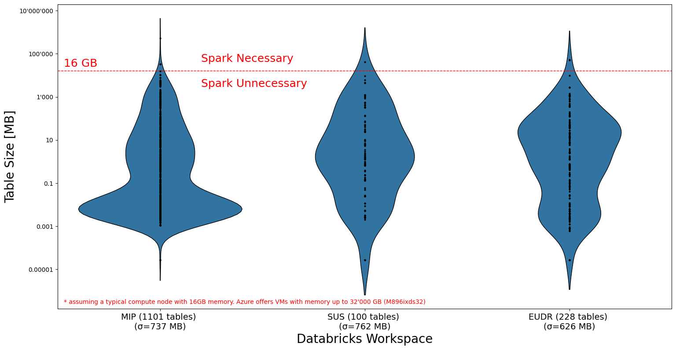
4. Scanning table sizes on Databricks workspaces at Company X

Slide 16
5. Potential solutions & Performance comparison with the best alternative
Use Spark on single node compute when working with tables less than ~16 GB (~1 billion rows)…
  an odd solution since negates the very purpose Spark was designed for: distributed compute ❌
  slow and complex compared to alternatives ❌
Use pandas or polars instead of Spark ✅
Criteria | Spark | Polars | Pandas
Github Stars (as of Oct 2025) | 42K | 36K | 47K
Parallelized? | Yes, across cores on many nodes | Yes, across cores on one node | No
Scalability | Scales horizontally across many nodes ("cluster computing") | Primarily scales vertically (single node) | Does not scale
Cost | Typically incurs higher costs due to the need for distributed computing resources & storage | Low: single node | Low: single node

Slide 17
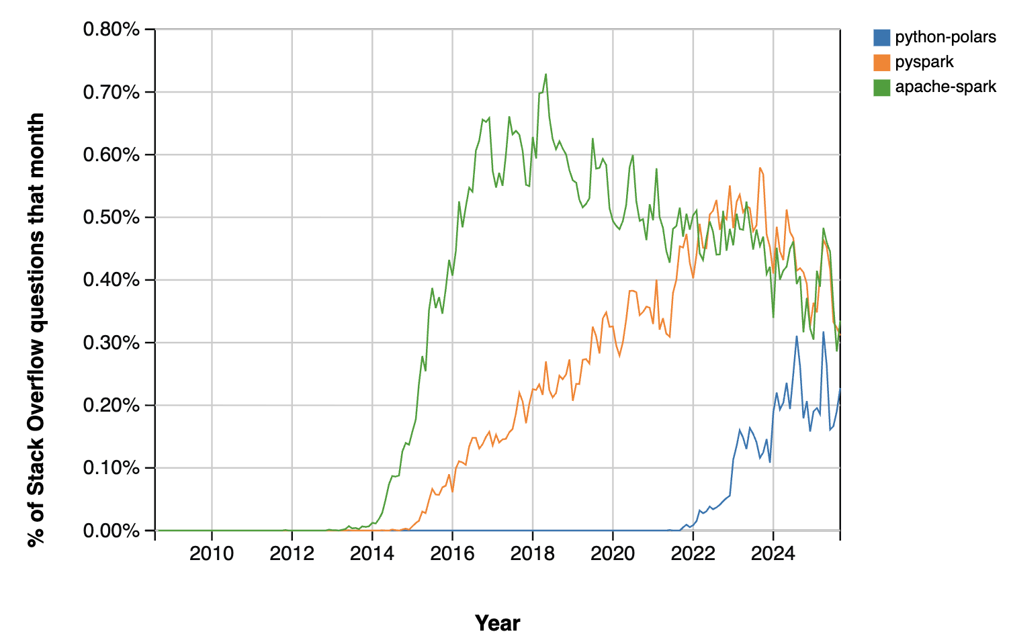
5. Potential solutions & Performance comparison with the best alternative

Slide 18
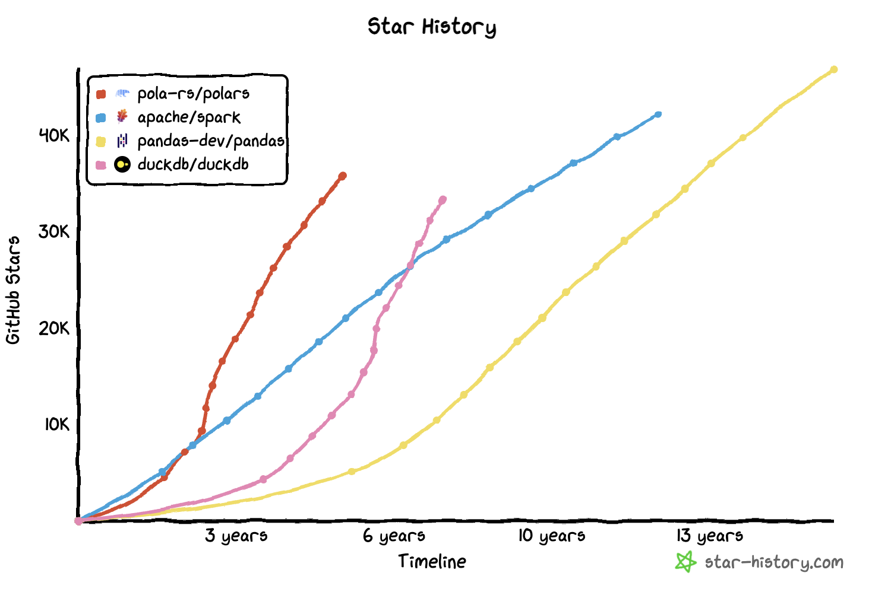
5. Potential solutions & Performance comparison with the best alternative
Polars is the fastest growing open source data project I am aware of

Slide 19
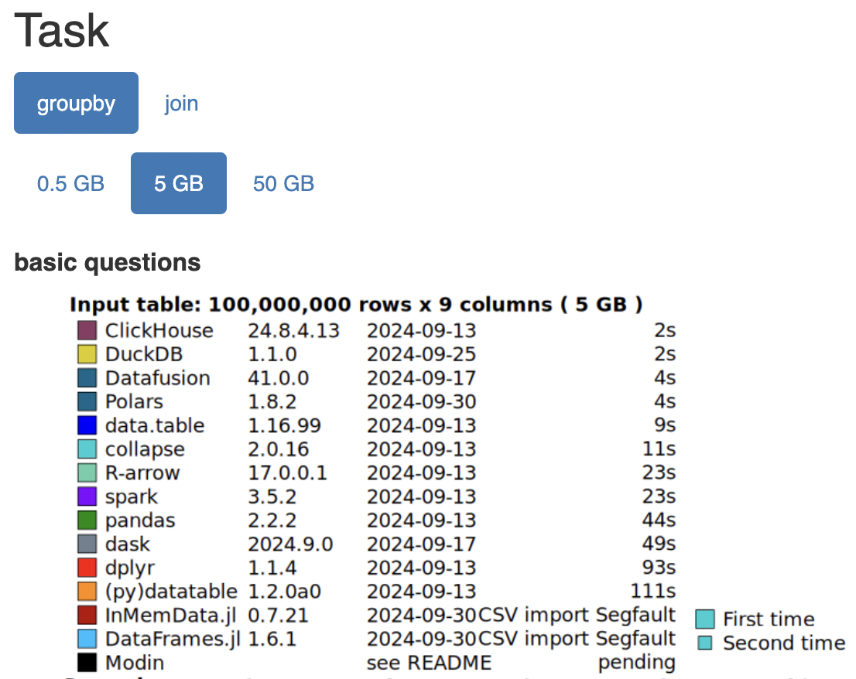
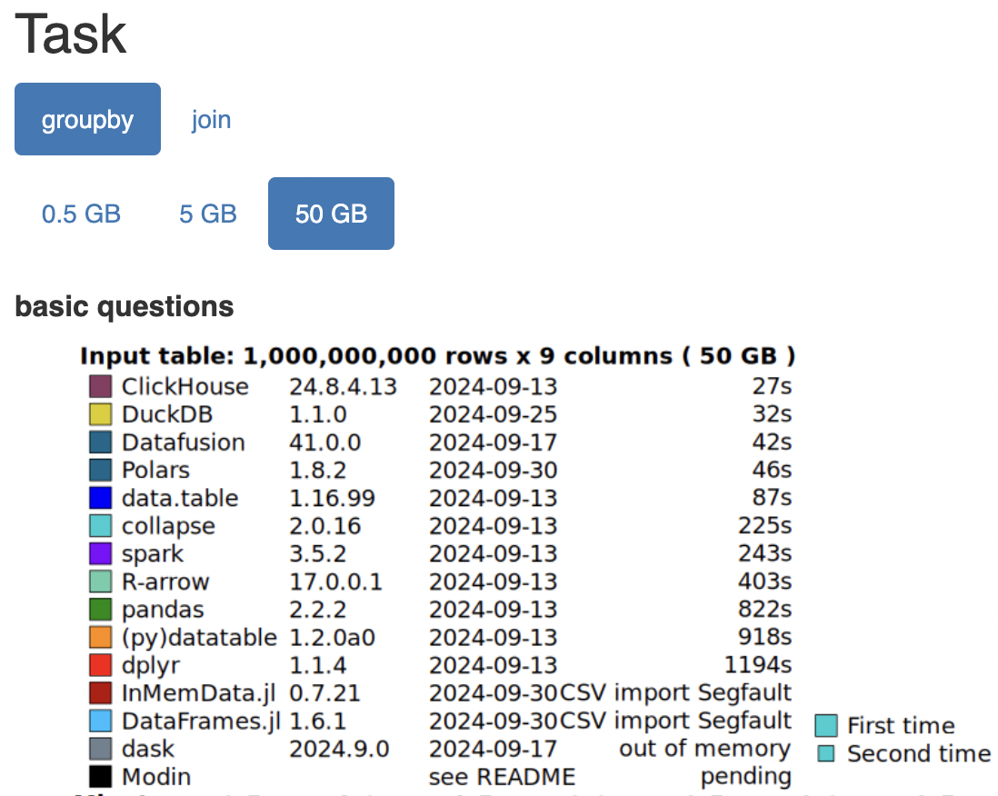
5. Potential solutions & Performance comparison with the best alternative
polars is a popular (35K+ github stars) library written in Rust for processing data in-memory on a single node, using pandas-like syntax.
benchmark performed on 5GB & 50GB tables (see full results here):
~3x cheaper than default Spark cluster on Databricks / Microsoft Fabric
~6x faster than Spark for "small data"

Slide 20
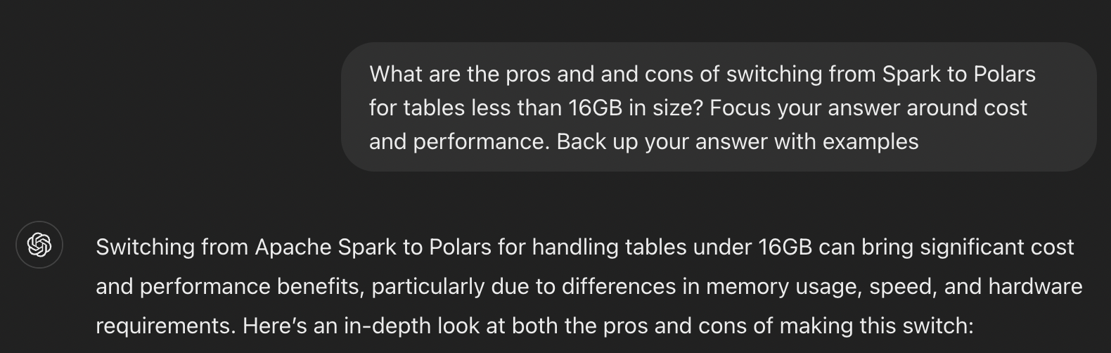
5. Potential solutions & Performance comparison with the best alternative
What does ChatGPT think?
Find full answer here.

Slide 21
6. Conclusions
"Big data" means data greater than what can fit into memory on 1 compute node
  Any table under 16GB (~1 billion rows) is generally not considered big data
  Memory on 1 Azure VM can be increased up to 32'000 GB (M896ixds32) ⇨ ~ 2 trillion rows
Company X hardly has big data (no tables above 1 TB): average table size on Databricks is under 1GB
Spark is necessary and performant on big data
Spark is unnecessary; non-performant; & expensive on "small data" (see previous slides that backup this statement)
  ~6x slower than polars
  ~3x more expensive than polars
Oliver loves polars because:
  It's fast (written in rust)
  It's usually all you need: runs on only 1 node and most data we work with on a day to day basis is not "big data"
  If your data size grows, you can vertically scale your VM (i.e. get more memory). Some VMs now have terabytes of memory!

Slide 22
7. Benchmarking Pandas (single thread) vs Polars (multi thread) — classroom exercise
The parallel compute logic (e.g. how joins or groupbys are distributed) between Spark & Polars is similar
Clone this repo locally: https://github.com/oliverangelil/AIMS_course_Pandas_vs_Polars
Follow installation instructions in the README
Benchmarking steps:
  Work in teams of 3
  Don't change any code & run all cells with the default number of threads available. A figure will be saved to your computer.
  Limit the threads to 1, by adjusting POLARS_MAX_THREADS. Restart kernel & run all. A new figure will be saved.
  Add a new benchmarking operation (parallelized, if you're on the left hand side of the class when facing front; non-parallelized, if you're on the right side)
  rename your .ipynb files to include the surnames of your team members, and send the following privately in slack to oliver, cyrille, & vincent before 10:00am:
    the .ipynb file
    2 .png figures for the groupby operation (1 figure for default thread count; 1 figure for 1 thread). ~10 minutes
    2 .png figures for the your new operation (1 figure for default thread count; 1 figure for 1 thread). ~40 minutes

Slide 23
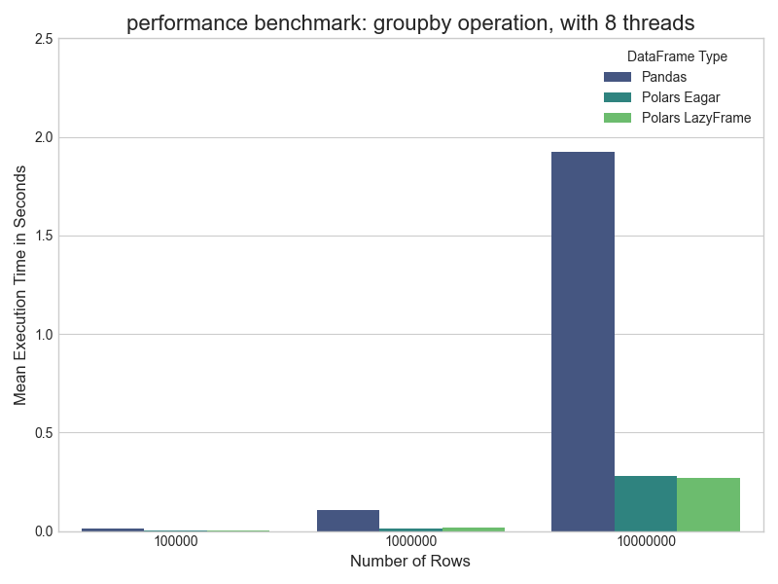
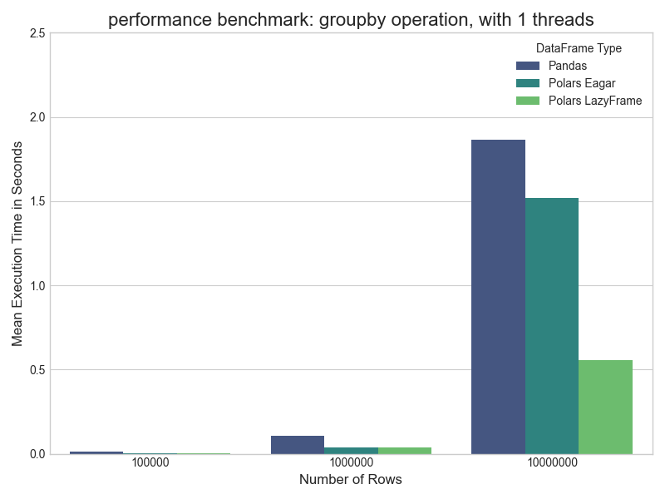
7. Benchmarking Pandas (single thread) vs Polars (multi thread) — classroom exercise

Slide 24
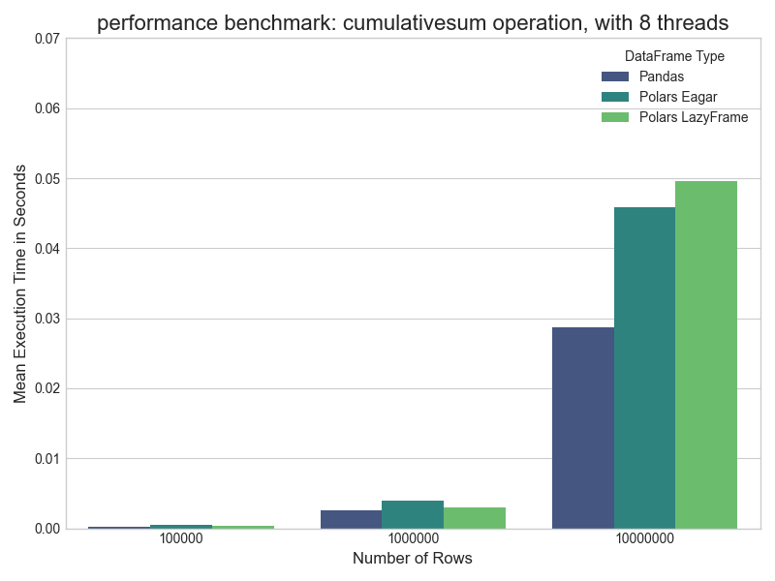
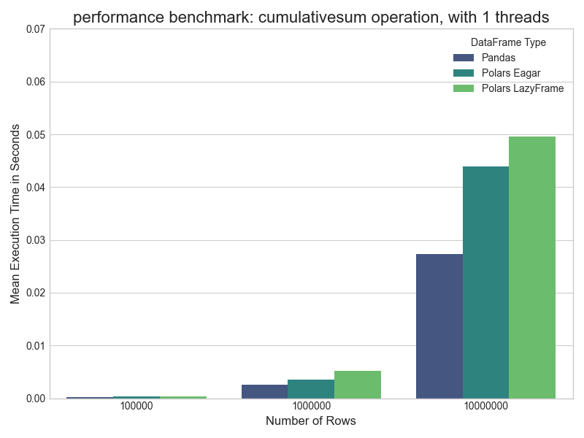
7. Benchmarking Pandas (single thread) vs Polars (multi thread) — classroom exercise

